Slide 1
Voltorb - November
Whack-a-mole with a microcontroller

Slide 2
Problem Statement
Mr. Bean is having trouble with a mole. In order to get rid of it, he must design a game of whack-a-mole. Alas, Mrs. Wicket has a few conditions about the components he can use. It cannot make use of LED. Design a whack-a-mole game that functions as follows:
The position of the mole must be displayed randomly every 3 seconds.
Each position should have a switch associated with it.
For the given random position, if the correct switch is pressed within 3 seconds, the player gets 5 points.
After the 3 seconds, that round ends, a new round begins. A new position should be displayed and steps 1-3 should be followed.
In case the wrong switch is pressed, the player gets 0 points.
At the end of 7 rounds, total score must be displayed.

Slide 3
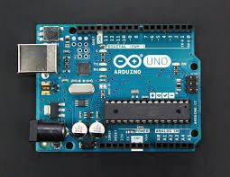

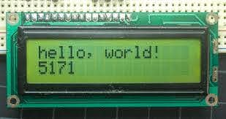
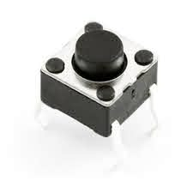
GANG MEMBERS
Arduino UNO/Nano
7 segment display/ LCD
Push buttons
This is what we’ll use to program the game to do as required.
This is to display the random positions of the mole and to display the final scores.
This is for the player to select the position. Every button is assigned one position.

Slide 4
ARDUINO:
The random function generates pseudo-random numbers. In this case, the range could be (1,4) or so.
Syntax:
random(min,max)
Declare the push buttons and pins for the display. Make the necessary connections, use serial print if needed.

Slide 5
7 segment display / LCD
Make the necessary connections, and get this to display the random number generated by the Arduino in each round. Also make sure to display the final score.

Slide 6
Push buttons
The number of push buttons is the maximum number that can be generated by the random function. Make the necessary connections, nothing much here.

Slide 7

WHACK-A-MOLE
Put the three together,
and the game is now
ready!
What’s another way to
approach this problem?

Slide 8
THANK YOU!
IEEE UVCE PES

